Slide 1
FLOOD MONITORING AND EARLY WARNING

Slide 2
PROBLEM STATEMENT
Flood management is a critical issue that requires effective strategies and solutions to mitigate the devastating impacts of floods. The problem at hand is to develop comprehensive flood management plans and systems that can minimize the loss of life, property damage, and disruption to communities caused by floods. This includes addressing the following key challenges:

Slide 3
Flood Monitoring: The system must be capable of continuously monitoring various flood-related parameters such as rainfall, river water levels, soil moisture, and weather forecasts. These data sources need to be integrated and analyzed in real-time to assess flood risk.

Slide 4
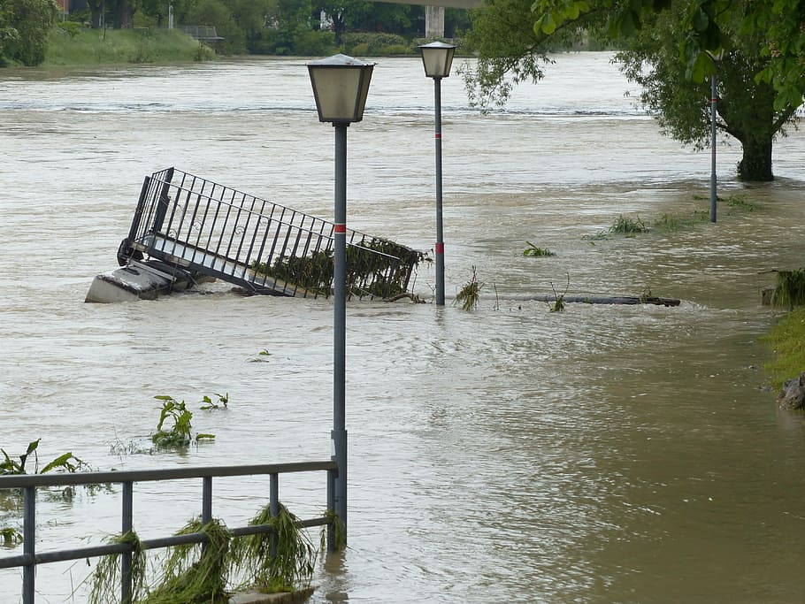
Early Warning: The system should provide timely and accurate warnings to residents and authorities before a flood event occurs. This involves establishing threshold levels for different parameters and triggering warnings when these thresholds are exceeded

Slide 5
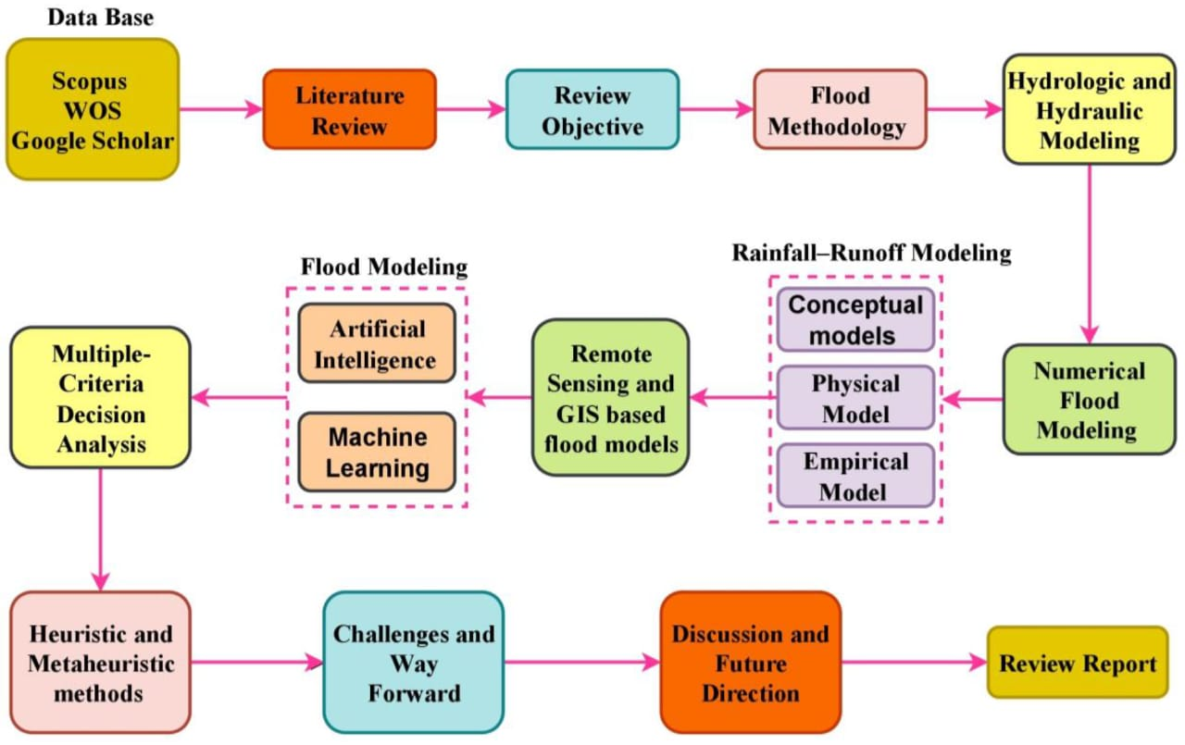
METHODOLOGY

Slide 6
HARDWARE COMPONENTS
Flood monitoring and early warning systems typically consist of various hardware components to gather data and provide timely alerts. Some of the key hardware components used in such systems include:
Rain Gauges: These devices measure the amount of rainfall in a specific area. They are essential for assessing precipitation levels and predicting potential flooding.

Slide 7
Early Warning Systems (EWS): Specialized EWS hardware integrates data from various sources, performs risk assessments, and triggers alerts and notifications to authorities and the public when flood threats are detected.
Power Backup Systems: Reliable power sources, such as generators and backup batteries, are crucial to ensure the continuous operation of monitoring equipment during power outages caused by severe weather events.

Slide 8
PROBLEM SOLUTION
Sensor Network Deployment: Install a network of flood sensors in flood-prone areas. These sensors can detect water levels , rainfall, and weather conditions
Data Collection and Transmission: Sensors should continuously collect data and transmit it to a central server or cloud platform. This data should include real-time information about water levels, rainfall, and weather forecasts

Slide 9
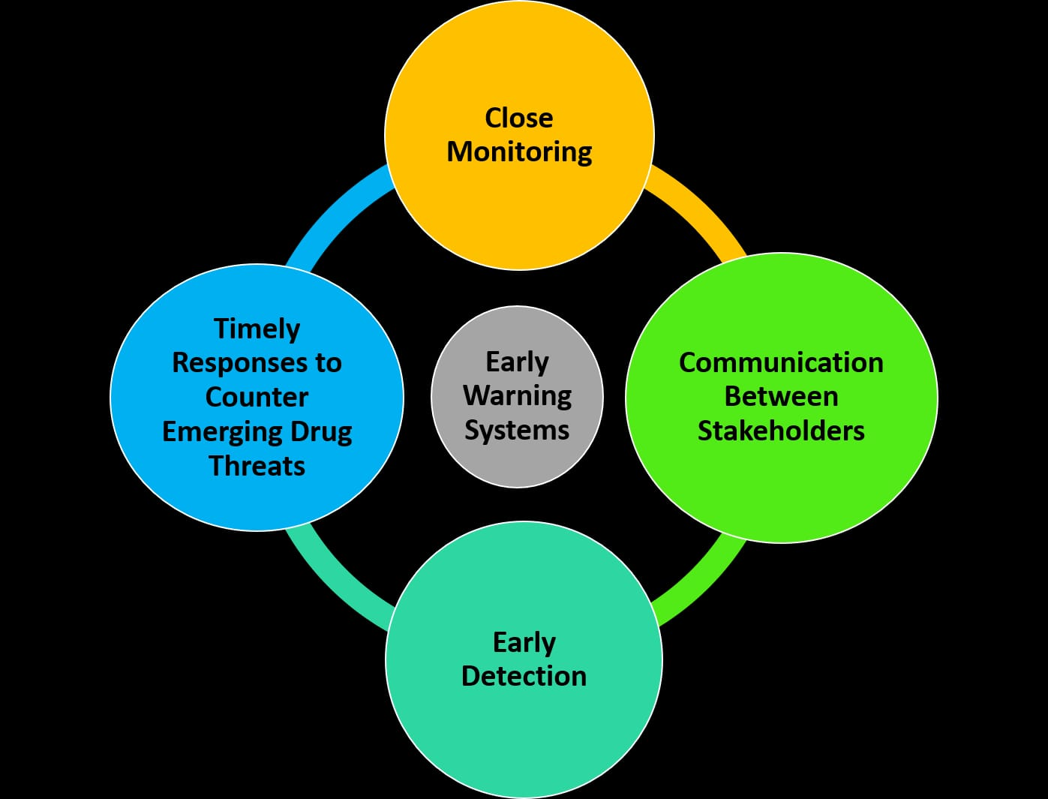
Satellite and Radar Systems: Remote sensing technologies, such as satellites and radar systems, provide broader-scale data on weather conditions, including rainfall intensity and storm movement.

Slide 10
CONCLUSION
In conclusion, flood monitoring and early warning systems play a crucial role in mitigating the devastating effects of floods. These systems, often based on advanced technology and data analysis, provide timely information to authorities and communities, enabling them to take proactive measures to protect lives and property. By investing in robust flood monitoring and early warning infrastructure, governments and organizations can significantly reduce the impact of floods, save lives, and minimize economic losses. However, it's essential to continuously improve and expand these systems, incorporating the latest advancements in technology and ensuring effective communication to reach vulnerable populations, thereby enhancing overall disaster resilience.

Slide 11
THANK YOU

